Slide 1
Music Junkies
Christopher Wuntsel
Rory Avant
Tony Hoss
Chris Vasquez

Slide 2
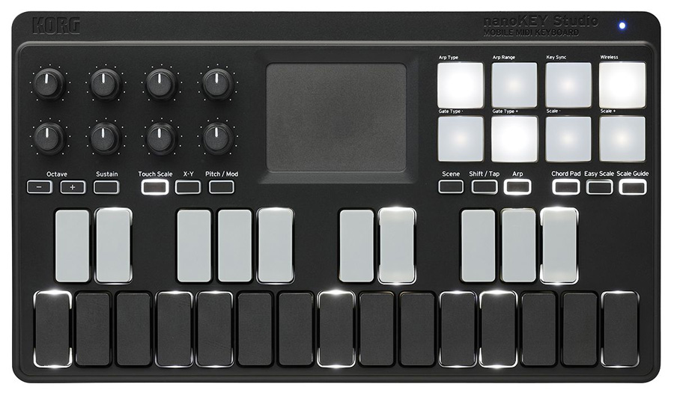
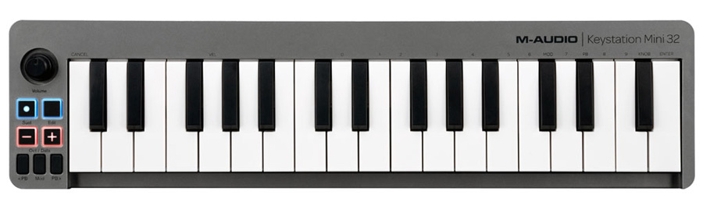
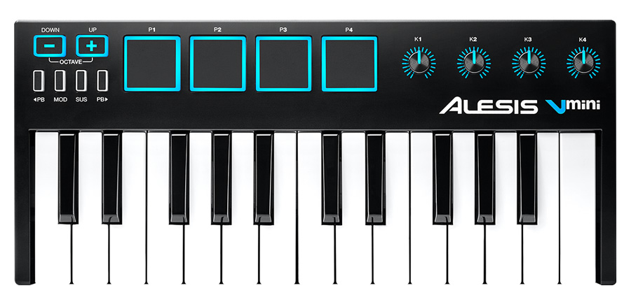
What is our Project?

Slide 3
What is our Project?
Built a cheaper midi controller
A piece of hardware that controls preexisting music software
Parameters controlled in that preexisted music software

Slide 4
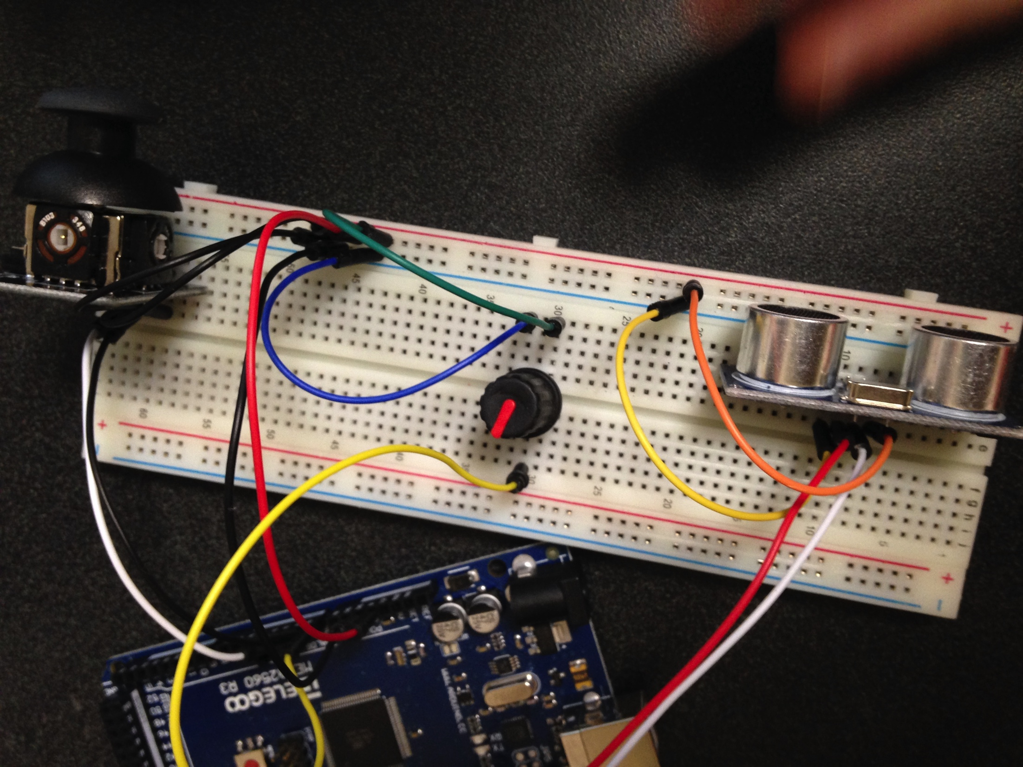
The Beginning Stages
Started with an arduino uno board
Ran into trouble with midi communication

Slide 5
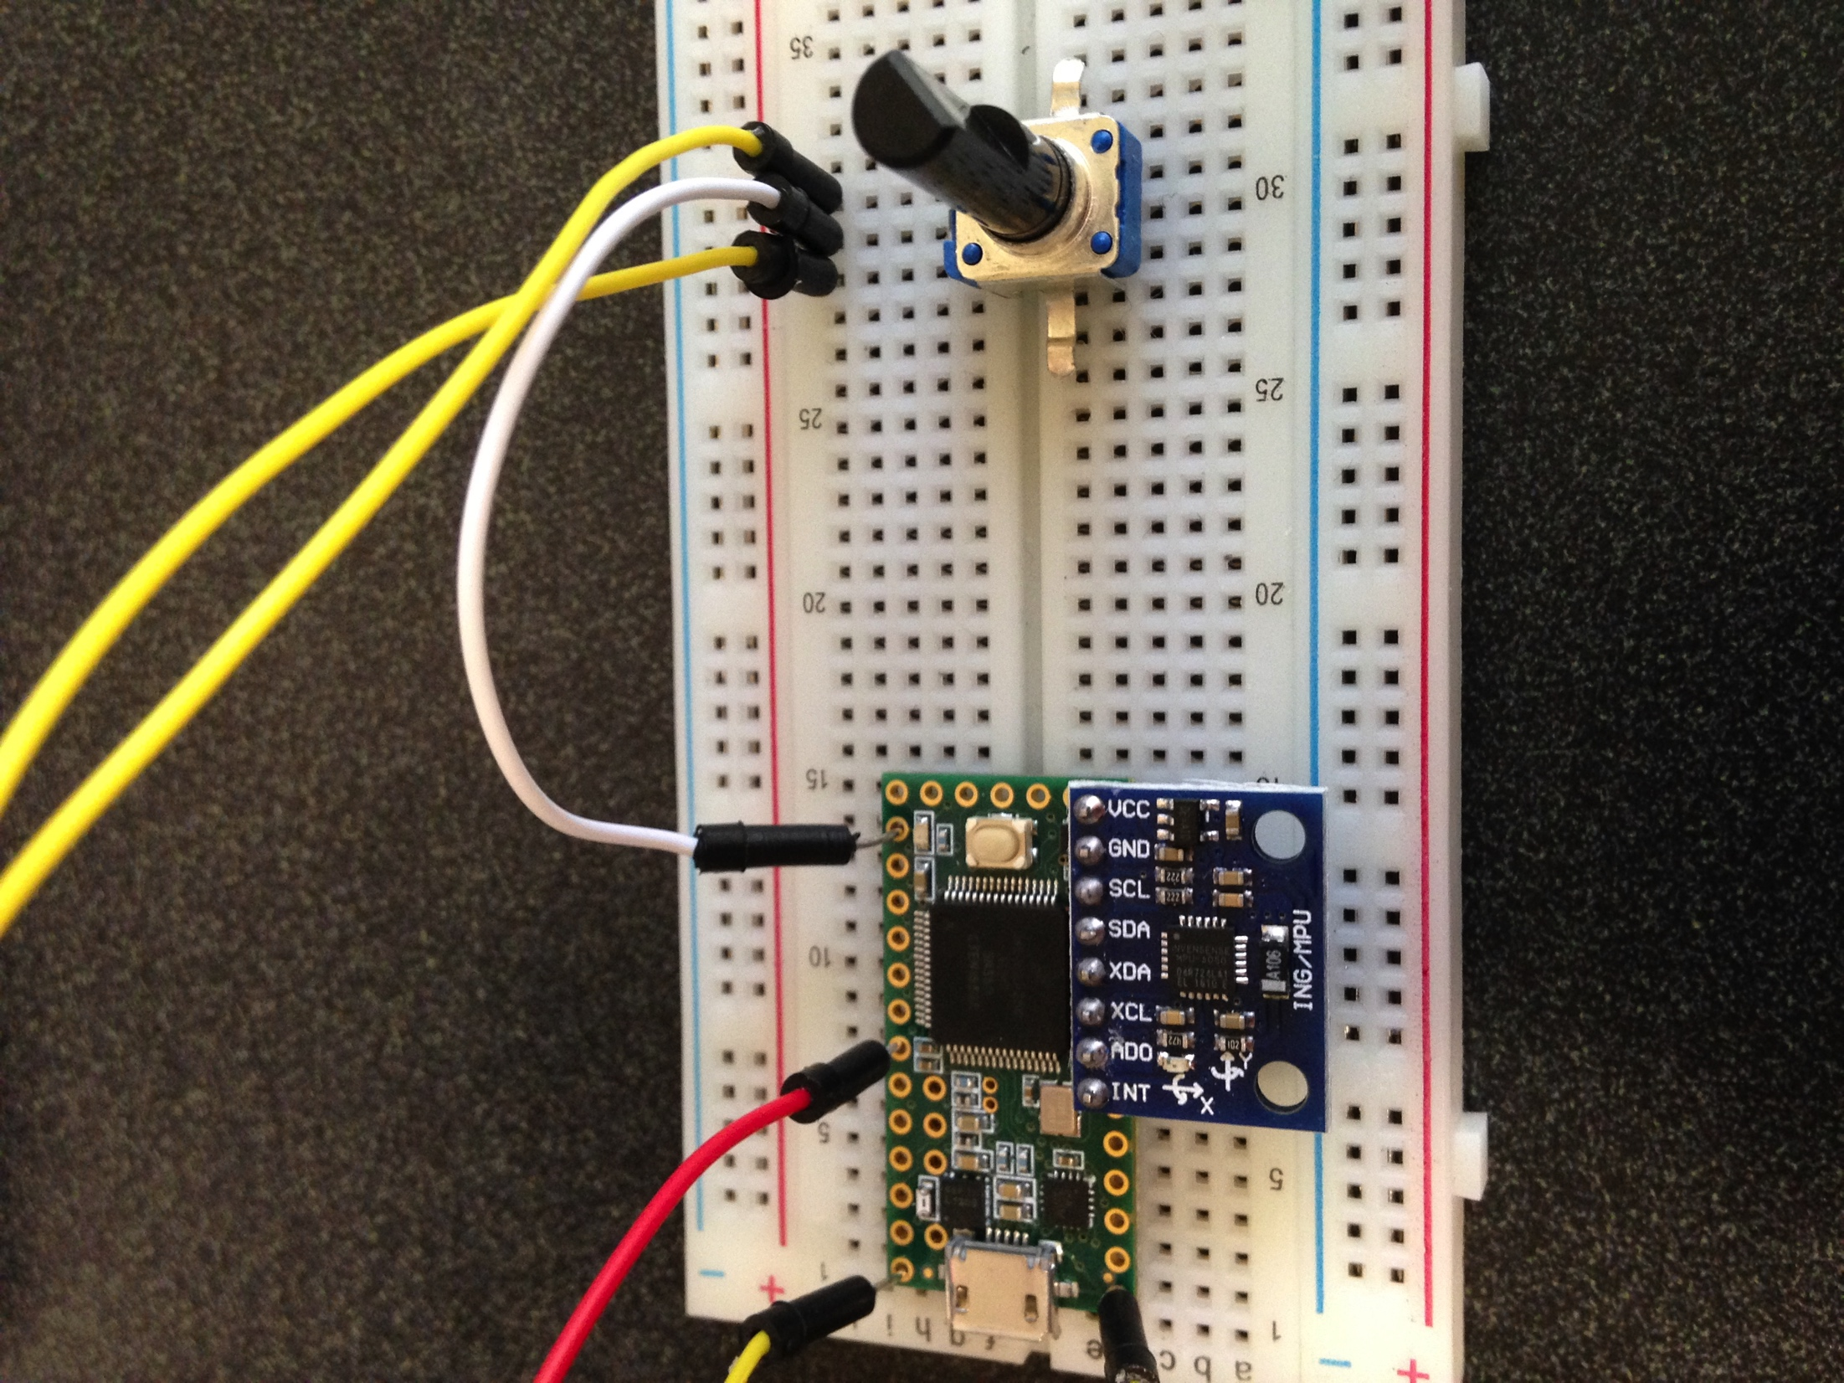
Progression
Switched to a Teensy board to accommodate for midi communication issues
Gutted an old guitar pedal as our midi controller housing
Filled the pedal with 5 potentiometers to control DAW

Slide 6
Final Product
Added Ultrasound Sensors
Extended the housing platform
Added button functionality to the gutted out guitar pedal

Slide 7
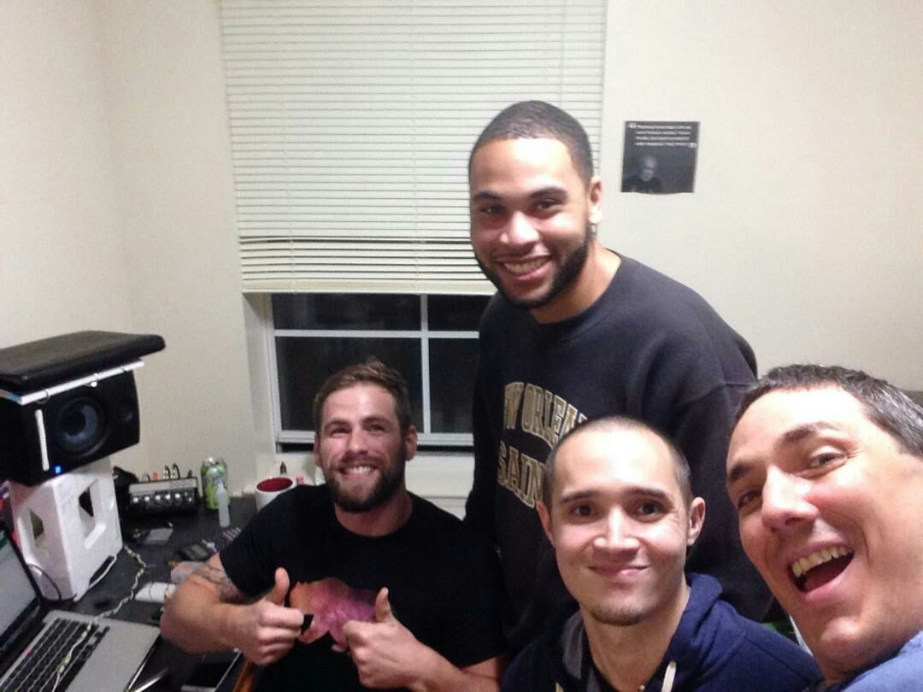
375 Takeaways
We loved and are proud of our project!
Noobs really had fun working on the hardware aspect
Learned a lot going forward

Slide 8
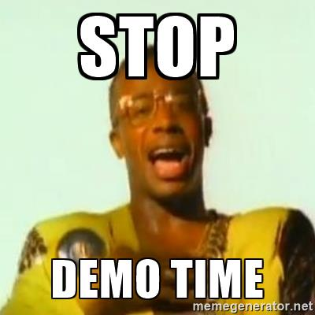
Demo

